Slide 1
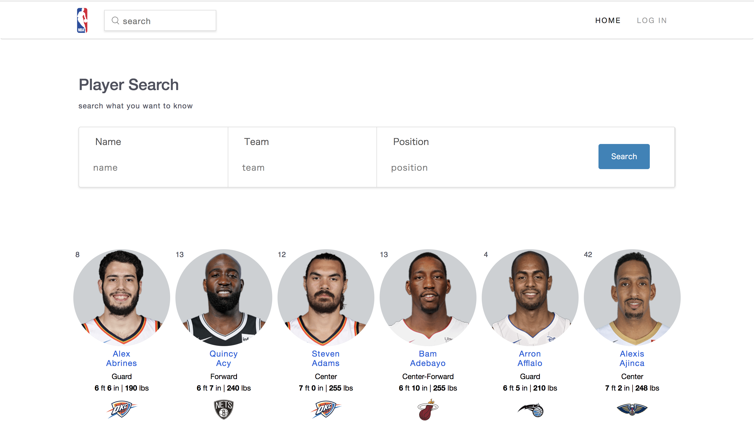
History players
INF551. Instructor: Wensheng Wu
Group members: Ruotian Jiang | Yuqiu He

Slide 2
Framework
Bootstrap + firebase + flask[a web framework written in python]

Slide 3
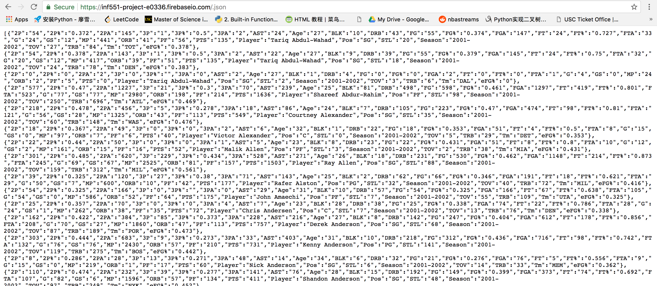
Data formate
Query methods
result =firebase_search.get('/', ’’)
firebase_savesSearch.post('/'+username,item)

Slide 4
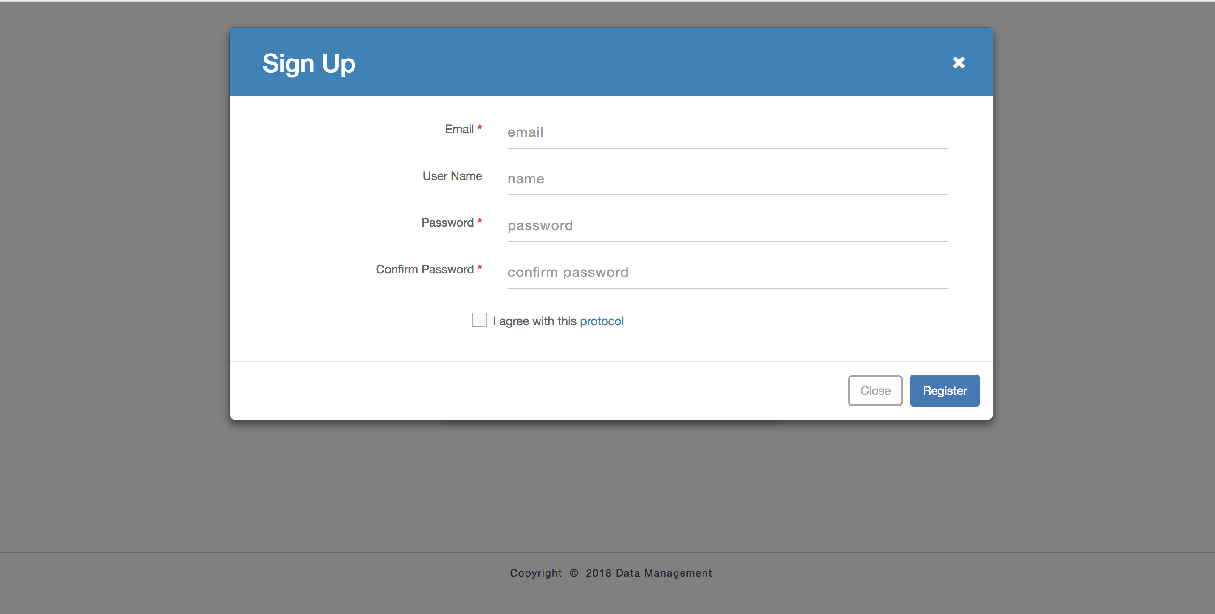
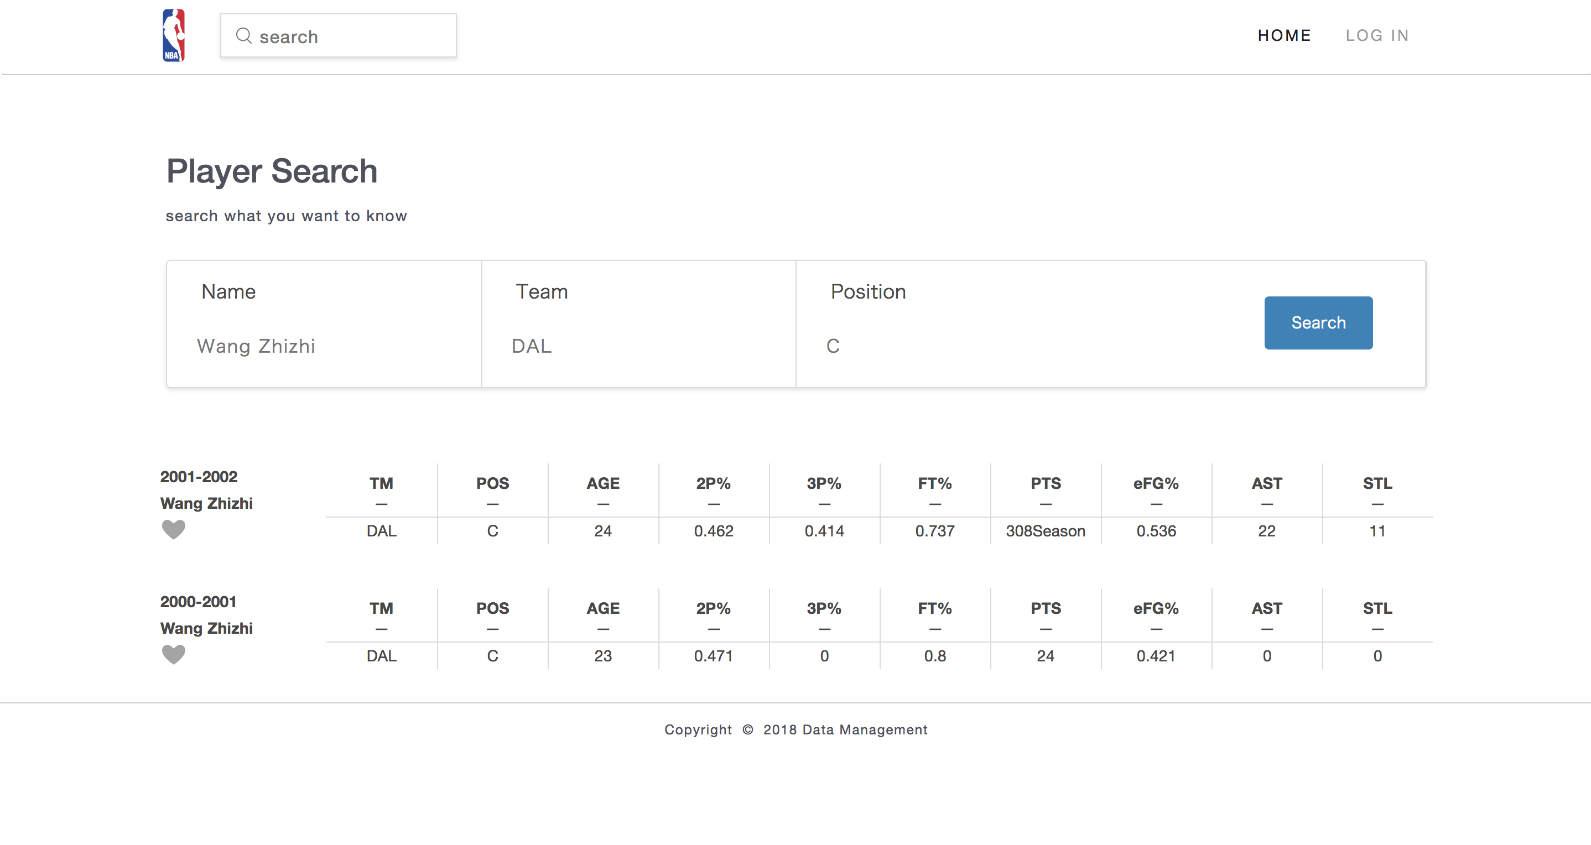
Fnished by Ruotian Jiang
Sign in and sign up
Keyword search
Note and delete search history

Slide 5
Fnished by Yuqiu He
Front-end design and implementation
Facet search
Save search history

